Slide 1

CourseFlow
By: Maame Nyarko, Tyler McDonald, Dulmini Perera, and Harold Guidry

Slide 2
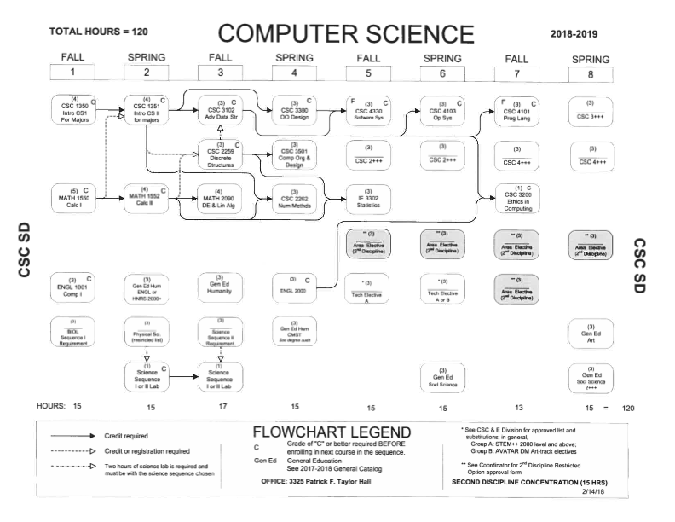

What is CourseFlow?

Slide 3





Powered by:

Slide 4


Main Features:
CourseFlow offers all of the following features for each individual student:
Sign Up page
Login page
Prerequisite Checker
Profile page
Home page

Slide 5
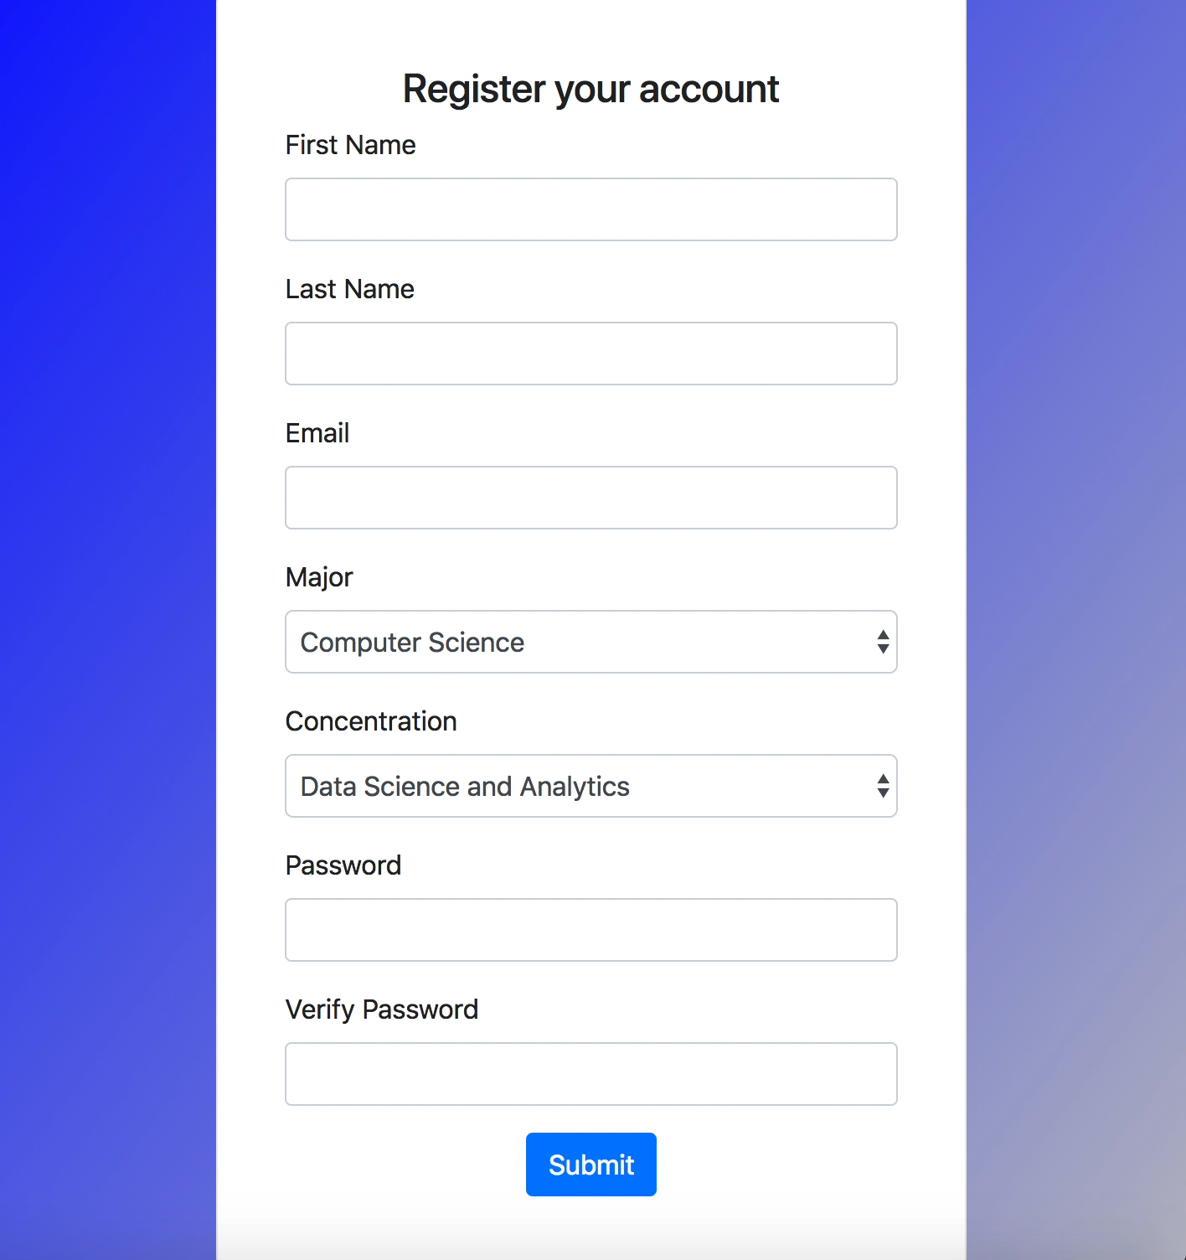
Demo: Sign up and Login Page

Slide 6
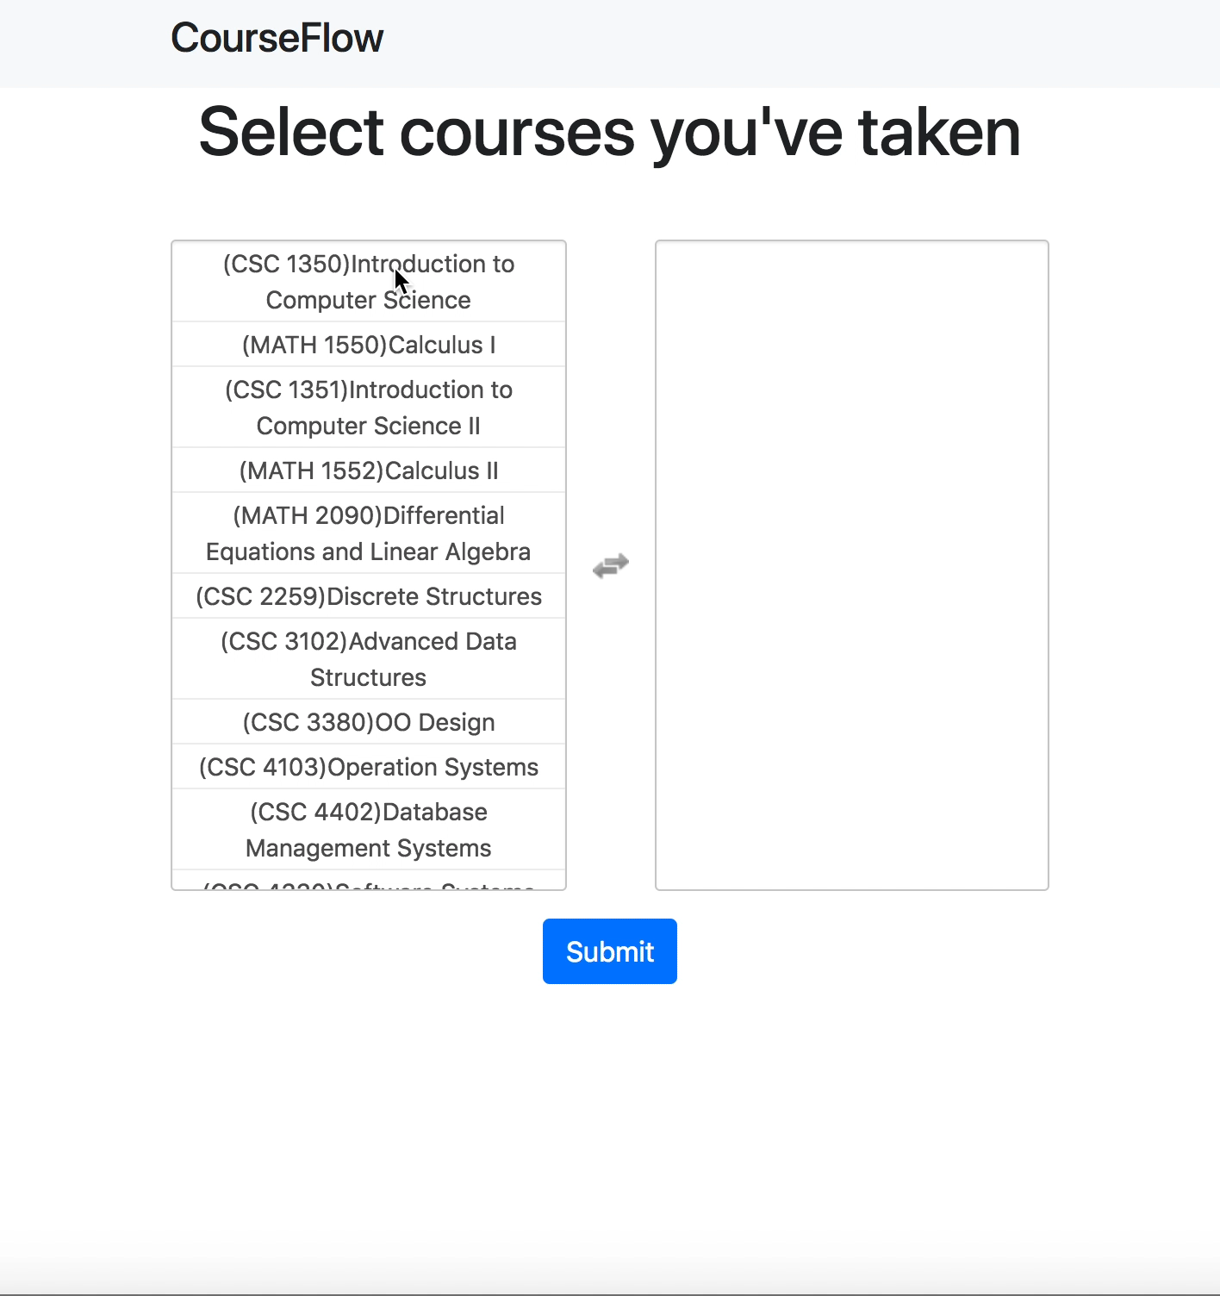
Demo: Prerequisite Checker

Slide 7
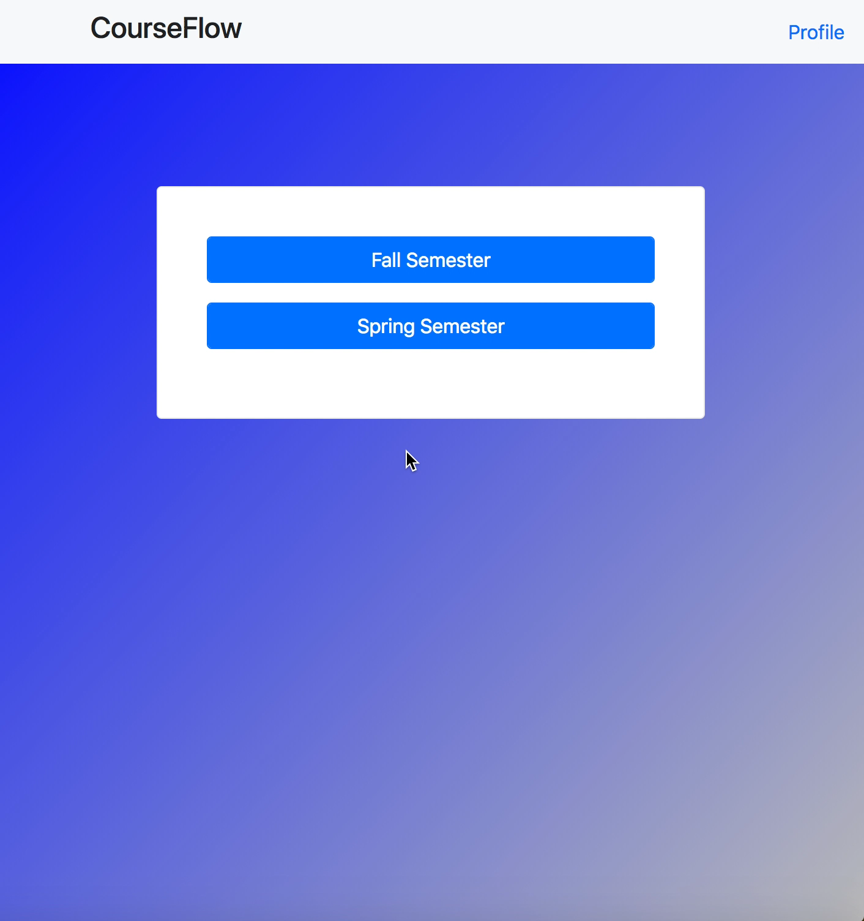
Demo: Home page and Profile page

Slide 8

Questions?

